Slide 1
Chapter VII. Simple form and combined form
（单形&聚形）
(The ideal shape of the crystal)
Simple form and simple form symbol
Theoretical derivation of simple form
47 geometric simple forms and 146 crystalline simple forms
Nomenclature of simple form
Combined form and its analysis
1

Slide 2
Chapter VII. Simple form and combined form
(The ideal shape of the crystal)
Simple form and simple form symbol
Theoretical derivation of simple form
47 geometric shapes and 146 crystalline simple forms
Nomenclature of simple form
Category of simple form
Combined form and its analysis

Slide 3
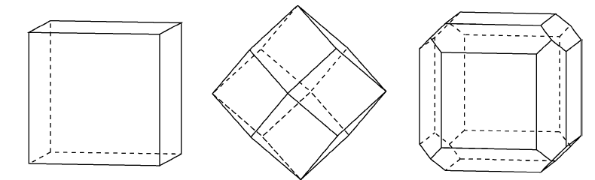
The ideal shape of the crystal
According to the type of crystal surface, the ideal crystal shape can be divided into two categories:
One is called simple form（单形）, which is composed of planes with the same size and shape;
The other one is composed by two or more kinds of crystal surface, known as the combined form（聚形）.
The combined is formed by the polymerization of simple forms.
{100}
{110}
{100}&{110}
Simple form
Combined form

Slide 4
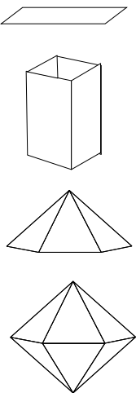
Simple form and its symbol
Simple form
  It is a combination of a set of crystal faces that are linked by symmetry elements.
  It means that a simple form is a group of crystal faces that can be operated by all the macroscopic symmetrical elements of the crystal so that they are repeated with each other.
  A group of crystal faces that are interrelated by all the symmetry elements of a point group.
  The properties, size and shape of all crystal surface of a simple form are the same.
  How to determine the number of crystal faces in a simple form and the shape of the simple form?
  The position of the initial crystal plane and the symmetry elements.

Slide 5
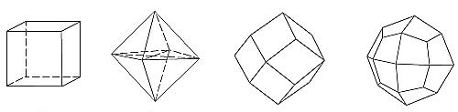
Examples
Octahedron
(八面体)
Rhombic dodecahedron
( 菱形十二面体)
Trapezohedron
(四角三八面体)
Cube
The shapes of these four simple forms are completely different, but the corresponding symmetry classes (point group 432, m3m, m3) can be the same or totally different；
The shape of crystals with the same symmetry class (point group) can be completely different. This is because the relationship between the crystal faces and the symmetrical elements is different.

Slide 6
Simple form symbol
The formation of simple form symbols
Among the crystal facets that belongs to a single form, choose a representative crystal facet according to the certain principles below , and writing its index in braces in order: {h k l} .
The crystal facet should be chosen with the highest positive index in the simple form. That is to choose the crystal surface in the first quadrant, Under this premise, make │h│≥│k│≥│l│.
In the simple forms of the middle and low crystalline families, the representative crystal facets are chosen according to the rule of "first upper, second front, and then right";
Among the advanced crystalline families, use the rule of “first front, second right, and then upper”.

Slide 7
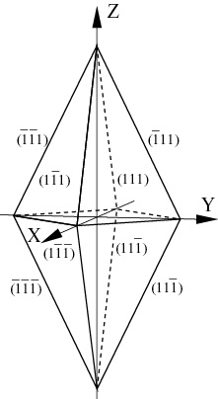
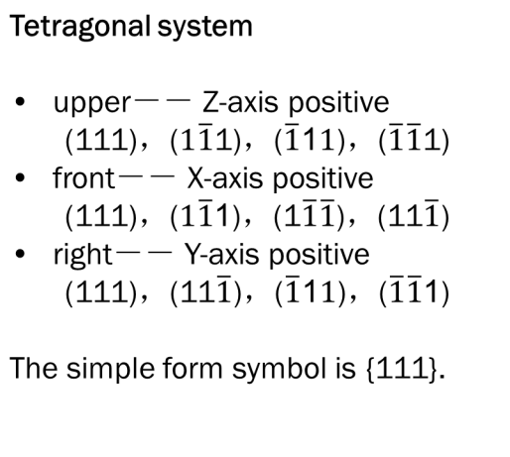
Simple form symbol

Slide 8
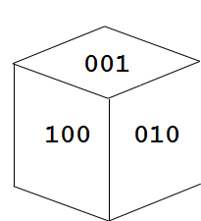



Simple form symbol
Cubic system
front － X-axis positive
right － Y-axis positive
upper－Z-axis positive
101
011
111
_
110
110
_
_
011
101
Exercise: please give the symbols of above simple forms.

Slide 9
Chapter VII. Simple form and combined form
(The ideal shape of the crystal)
Simple form and simple form symbol
Theoretical derivation of simple form
47 geometric shapes and 146 crystalline simple forms
Nomenclature of simple form
Category of simple form
Combined form and its analysis

Slide 10
Simple form derivation
Process for the derivation:
Set one original crystal facet in a symmetry class or point group and obtain other facets by symmetry operations.
These facets form a simple form together.

Slide 11
Simple form derivation
The symmetry class mm2 (L²2P) in orthorhombic system is taken as an example to illustrate the derivation of the simple form.
Position1：single face{001}
Position2：pinacoid{100} (平行双面）
Position3：pinacoid {010}
Position4：two-sided{h0l}
Position5： two-sided {0kl}
Position 6： Rhombic prism{hk0}
Position 7： Rhombic simple cone{hkl}
Z
Y
Y
X
X
The resulted shape may be different if the position of the original crystal facet varies.

Slide 12
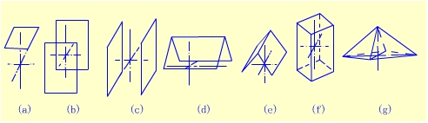
Simple form derivation
In the 7 single forms, the second and third simple forms are exactly the same, and the fourth, fifth simple forms are exactly the same (shape and symmetry), so that these can be considered as one simple form. Therefore, the symmetry class mm2 consists of 5 single forms.

Slide 13
Special form and general form
The single forms in which there is special relationship between crystal facets and symmetry elements “(such as vertical, parallel or intersecting with the same symmetry elements with the same angle) are called special forms, otherwise are called general forms.
Each crystal system has different symmetry elements and distribution, so different positions need to be considered.

Slide 14
Theoretical deduction of simple form
For lower crystal category, consider positions: {hkl}, {0kl}, {h0l}, {hk0}, {100}, {010}, {001}
For tetragonal point groups, consider positions:{hkl}, {hhl}, {h0l}+{0kl}, {hk0}, {110}, {100}, {001}
For trigonal/hexagonal system point group, consider positions: {hkil}, {hh-2hl}, {h0-hl}, {hki0} {11-20}, {10-10}, {0001}
For higher crystal category, consider positions: {hkl}, {hhl}, {hkk}, {hk0}, {111}, {110}, {100}
Symmetrical operation of the original crystal plane of the above position, drawing the projection of all crystal faces, and then determine what kind of simple forms it is.

Slide 15
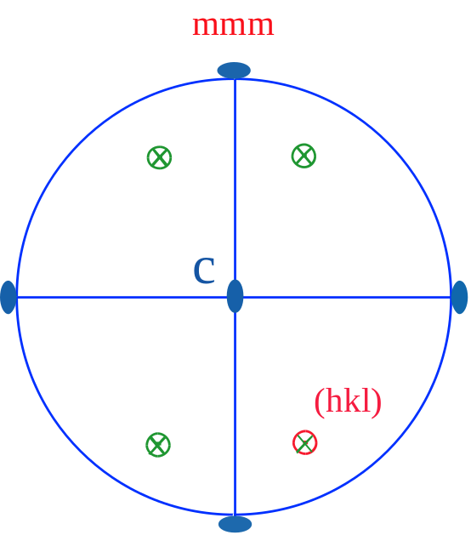
Theoretical deduction of simple form
Simple form mmm in lower crystal category
1. { h k l}
This form has a total of 8 facets, each of which intersects the crystal axis (perpendicular to paper plane through center point)
This simple form is determined as a rhombic dipyramid（斜方双锥）
The blue graph gives the projection of symmetry elements
The red circle is the original crystal facet
The green graphs are the projection of facets created by symmetry operations
Above equatorial plane
Under equatorial plane

Slide 16
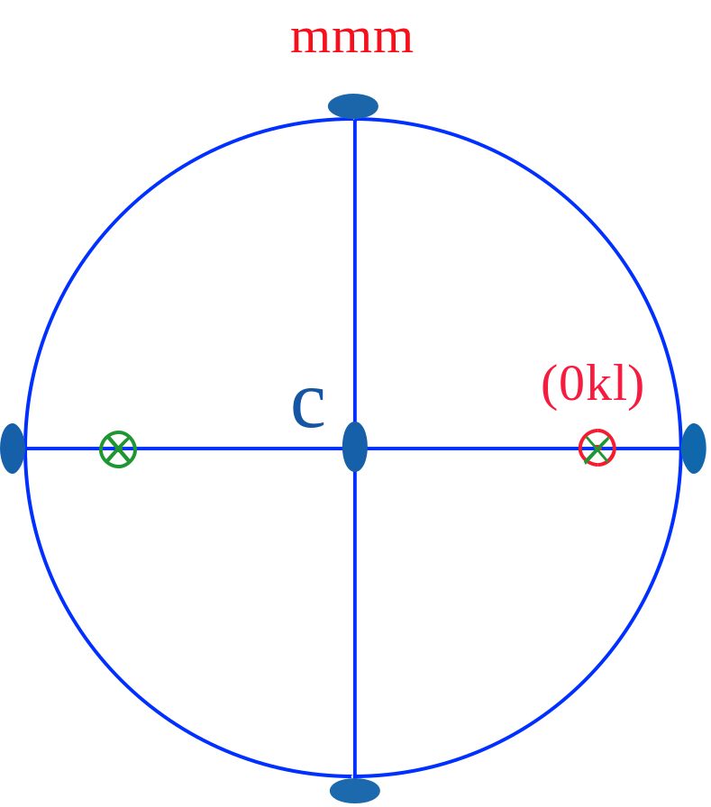
Theoretical deduction of simple form
Simple form mmm in lower crystal category
2. {0kl}
This form has a total of 4 facets, each of which intersects the crystal axis
Judge this simple form as an Rhombic prism

Slide 17
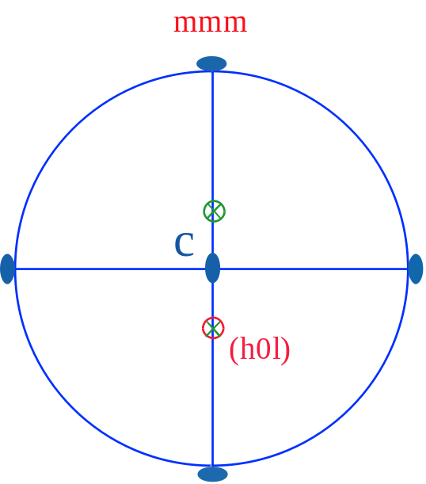
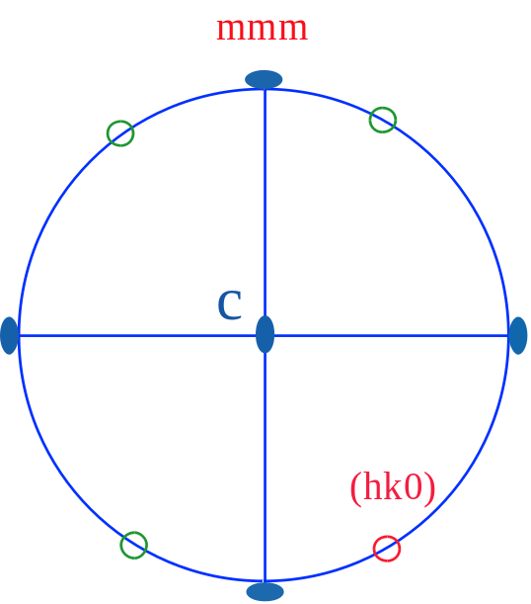
Theoretical deduction of simple form
Simple form mmm in lower crystal category
3. {h0l}, 4. {hk0}
Each of these two simple forms has 4 crystal surfaces and this simple forms can be determined as Rhombic prisms.

Slide 18
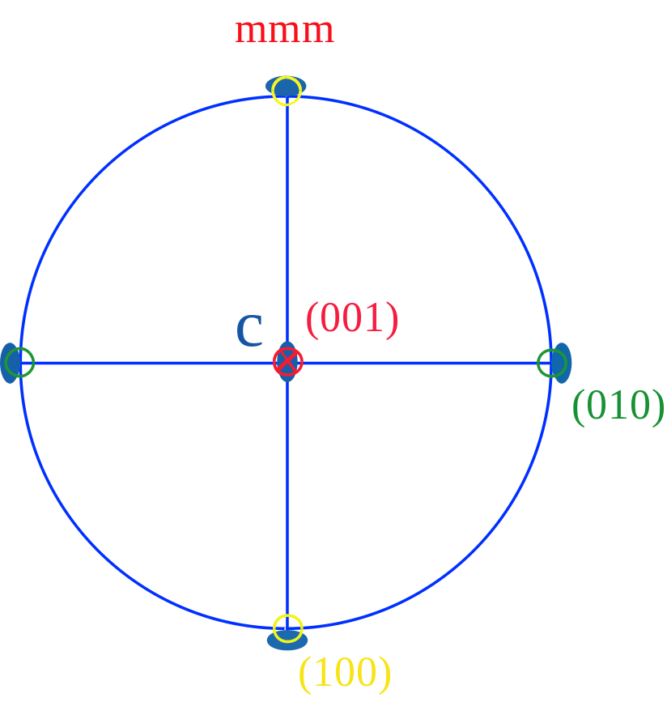
Theoretical deduction of simple form
Simple form mmm in lower crystal category
5. {100}, 6. {010}, 7. {001}
The red is {001} crystal face
The green is {010} crystal face
The yellow is {100} crystal face
Each of these three simple forms has three crystal facets. The simple forms are determined as pinacoids.

Slide 19
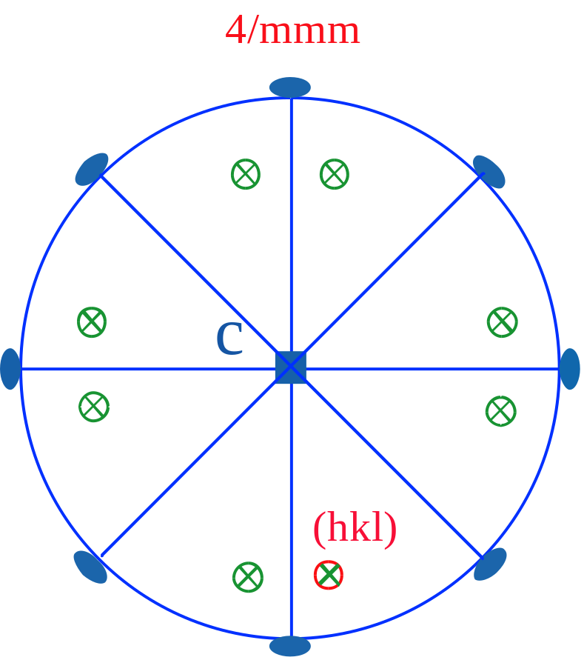
Theoretical deduction of simple form
Simple form 4/mmm in tetragonal system
1. {hkl}
This simple form has 16 crystal facets. This simple shape is determined as a complex quadrilateral cone

Slide 20
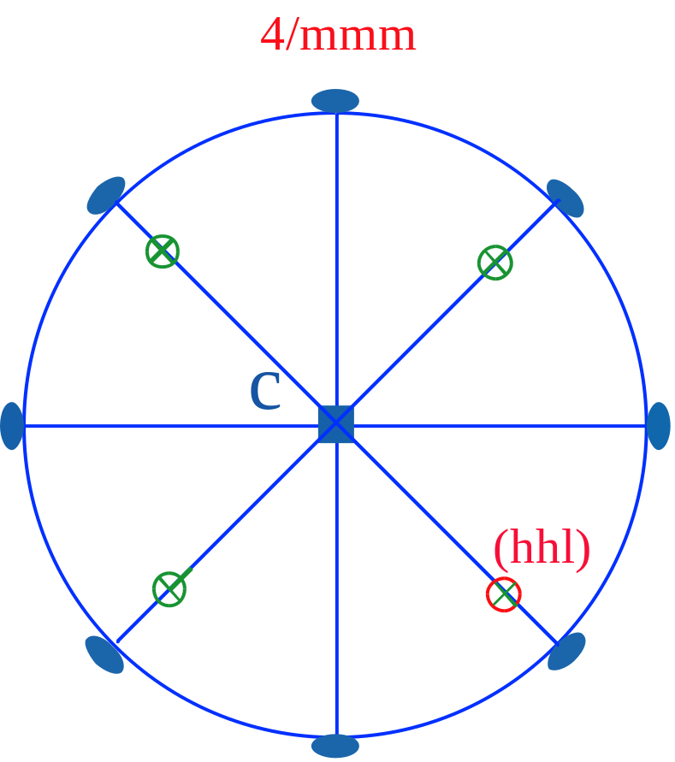
Theoretical deduction of simple form
Simple form 4/mmm in tetragonal system
2. {hhl}
The single form has 8 crystal facets. It is determined as tetragonal dipyramid.
{h0l}and{0kl}also are tetragonal dipyramid

Slide 21
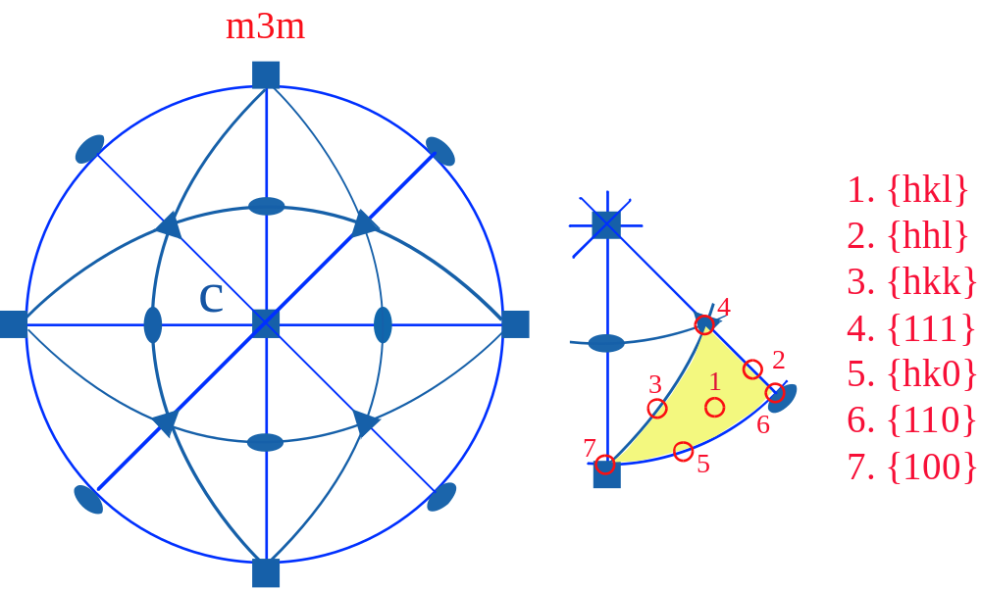
Theoretical deduction of simple form
Simple form m3m in isometric system
Seven initial facet position in the arc triangle of above picture are considered for deduction of simple forms.

Slide 22
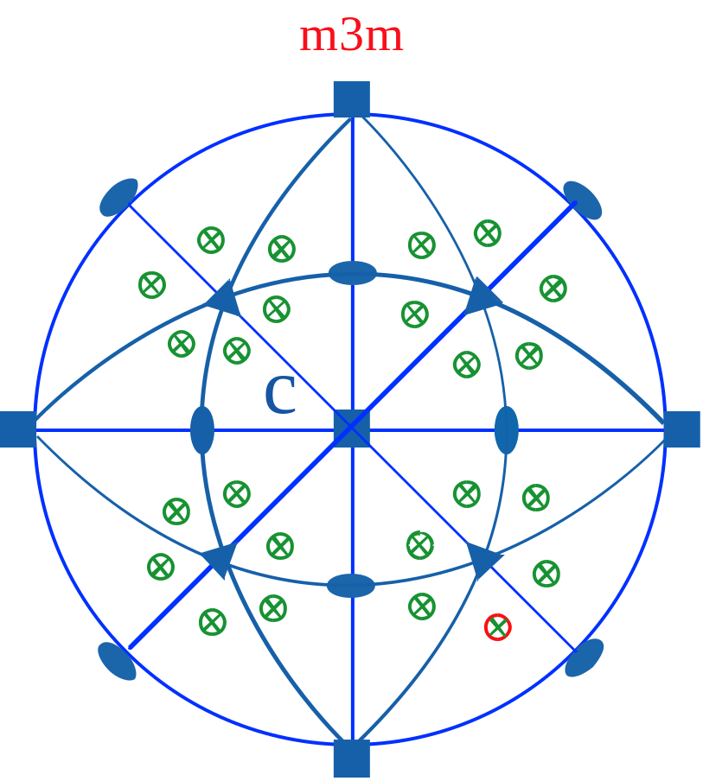
Theoretical deduction of simple form
Simple form m3m in isometric system
1. {hkl}
This simple form has 48 crystal facets. It is determined as hexoctahedron（六八面体）.
Derive the simple forms of other positions

Slide 23
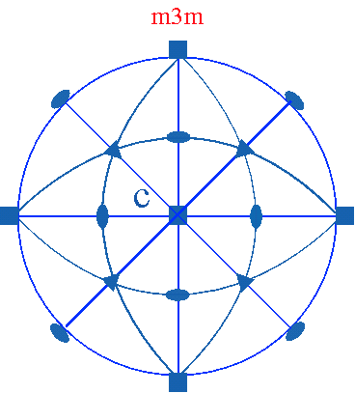
Theoretical deduction of simple form
Simple form m3m in isometric system
2. {hhl}

Slide 24
Theoretical deduction of simple form
Simple form m3m in isometric system
2. {hhl}
This single form has 24 crystal facets. It is determined as a triakisoctahedron（三角三八面体）.

Slide 25
Theoretical deduction of simple form
Simple form m3m in isometric system
3.{hkk}

Slide 26
Theoretical deduction of simple form
Simple form m3m in isometric system
3.{hkk}
This simple form has 24 crystal facets. It is determined as tetragonal trisoctahedron （四角三八面体）

Slide 27
Theoretical deduction of simple form
Simple form m3m in isometric system
4. {hk0}

Slide 28
Theoretical deduction of simple form
Simple form m3m in isometric system
4. {hk0}
This simple form has 24 crystal facets. It is determined as tetrahexahedron（四六面体）.

Slide 29
Theoretical deduction of simple form
Simple form m3m in isometric system
Exercise: derive the simple forms of {111}, {110}, {100} positions

Slide 30
Summary
Using an arbitrary crystal face in a simple form as the original crystal facet, all crystal face can be derived from the symmetric action in the symmetric type;
Different single forms can be derived because the different relative positions between the same symmetry class and the original crystal facets;
The simple forms with the same shape that are deduced from the different symmetry classes are different on their symmetry.

Slide 31
Chapter VII. Simple form and combined form
(The ideal shape of the crystal)
Simple form and simple form symbol
Theoretical derivation of simple form
47 geometric shapes and 146 crystalline simple forms
Nomenclature of simple form
Category of simple form
Combined form and its analysis

Slide 32
Crystallographic simple form and geometric simple form
A symmetry class can derive out at most 7 single forms.
32 symmetry classes are deduced one by one and 146 different simple forms can be obtained, which are called crystallographic simple forms.
Reference（P.60 table 5-1～5-7）

Slide 33
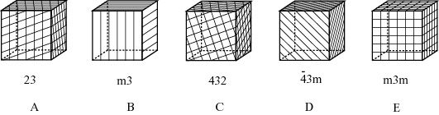
Crystallographic simple form and geometric simple form
In the 146 crystallographic simple forms, many simple forms have the same shapes, as shown in the following 5 cubes. If we regard the simple forms with same shape as a simple form, the 146 crystalline forms can be classified into 47 geometric simple forms

Slide 34
47 geometric simple form
To descript simple forms, it is necessary to consider number, shape, relationship of crystal facets, the relative position of crystal facets and symmetry elements, and the transverse section of simple forms.
The number and shape of crystal facets in a simple form are often the main basis for nomenclature.
Methods for the nomenclature of simple forms are shown in textbook, P.67-69
1. Facet type Isometric system ：
2. Column type 1. Tetrahedron group
3. Single cone 2. Eight body group
4. Double cone 3. Cube set
5. Surface class
6. Folk prescription

Slide 35

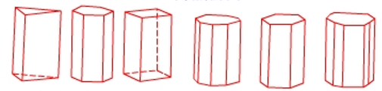

47 geometric simple form
Simple forms of lower crystalline category
1 Pedion; 2 Pinacoid; 3 Reflection and axis dome; 4 Rhombic prism;
5 Rhombic tetrahedron; 6 Rhombic simple cone; 7 Rhombic double cone
Simple forms of Intermediate category
8 Trigonal prism; 9 Ditrigonal prism; 10 Tetragonal prism;
11 Ditetragonal prism; 12 Hexagonal prism; 13 Dihexagonal prism
14 Trigonal bipyramid; 15 Ditrigonal bipyramid; 16 Tetragonal pyramid;
17 Ditetragonal pyramid; 18 Hexagonal pyramid; 19 Complex hexagonal single cone

Slide 36
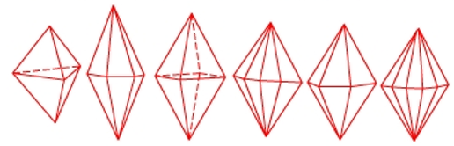



47 geometric simple form
Simple forms of Intermediate category
20 Trigonal bipyramid; 21 Ditrigonal bipyramid; 22 Tetragonal dipyramid;
23 Ditetragonal dipyramid; 24 Hexagonal bipyramid; 25 Dihexagonal-dipyramidal
Cross-section of various columns and cones
26 Quartet tetrahedron; 27 Rhombohedral;
28 Trigonal tetragonal plane; 29 Ditrigonal scalenohedron
1,3,5 left handed form
2,4,6 right handed form
30 Trigonal trapezohedron; 31 Tetragonal folk prescription; 32 Hexagonal trapezohedron

Slide 37



47 geometric simple form
Simple forms of higher crystalline category
4 left handed form
5 right handed form
33 Tetrahedron; 34 Triakistetrahedron; 35 Deltohedron;
36 Tetartoid; 37 Hexatetrahedron
4 left handed form
5 right handed form
38 Octahedron; 39 Triakisoctahedron; 40 Tetragonal trisoctahedron;
41 Pentagonal icositetrahedron; 42. Hexoctahedron
43 Cube; 44 Tetraxishexahedron; 45 Granatohedron;
46. Pyritohedron; 47 Diakisdodecahedron

Slide 38
Chapter VII. Simple form and combined form
(The ideal shape of the crystal)
Simple form and simple form symbol
Theoretical derivation of simple form
47 geometric shapes and 146 crystalline simple forms
Nomenclature of simple form
Category of simple form
Combined form and its analysis

Slide 39
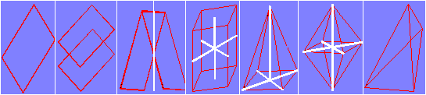
Nomenclature of simple form
Lower crystal category - 7 types
Pedion： a single facet;
Pinacoid： a pair of facets parallel to each other;
Dome/sphenoid：including reflecting double facets and axis double sided. They are a pair of intersecting facets;
Rhombic prism：Four groups of two parallel crystal facets. Their edges are parallel and the cross section is rhomboic.
Rhombic pyramid： It consists of four identical inequilateral triangles, which intersect at one point, the bottom is rhomboic. A L₂ passes through the vertex of the pyramid and the center of bottom.
Rhombic dipyramid: It consists of two identical oblique square cone, which connect with bottom to bottom.
Rhombic tetrahedron（ 菱形四面体 ）：It is composed of identical inequilateral triangles, which facets are not parallel to each other. The middle point of each edge is passed by a L₂. The cross section passing through the middle point of each crystal is diamond-shaped.

Slide 40
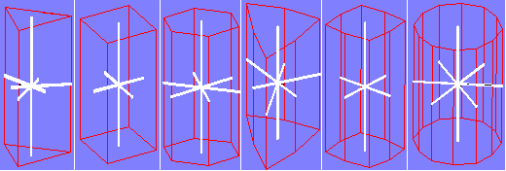
Nomenclature of simple form
Intermediate crystal category - 25 new types
The simple forms has a higher order axis. Pedion and pinacoid appear when crystal facets are perpendicular to the higher order axis.
1) Column: They are surrounded by a number of crystal faces, their edges are parallel to each other and parallel to the higher axis. They are divided into 6 kinds according to the shape of cross sections： trigonal prism, ditrigonal prism, tetragonal prism, ditetragonal prism, hexagonal prism, dihexagonal prism.

Slide 41
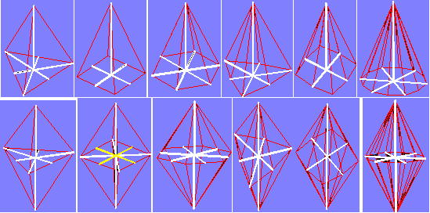
Nomenclature of simple form
Intermediate crystal category- 25 new types
2) Simple cone: Several isosceles triangular planes intersect with a higher axis at a point and the bottom is perpendicular to the high order symmetry axis, which has the same shape as that in the column type. There are six simple forms: trigonal pyramid, ditrigonal pyramid, tetragonal pyramid, ditetragonal pyramid, hexagonal pyramid dihexagonal pyramid;
3) Double cone: Two identical single cones are connected by bottom facet to bottom facet. There are six single forms: trigonal bipyramid, ditrigonal bipyramid, tetragonal dipyramid, ditetragonal dipyramid, hexagonal bipyramid, dihexagonal-dipyramidal.

Slide 42
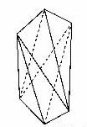


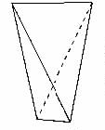
Nomenclature of simple form
Intermediate crystal category- 25 new types
4) Tetrahedron: There are two types. A quartet tetrahedron consists of four non-parallel isosceles triangles. The bottom of two interphase crystal facets intersects. L₂ or L_{i}⁴ passes through the midpoint of each edge. The cross section that passes through the middle points of the waist is square. A ditetragonal scalenohedron divides the plane of a tetrahedron into two scalene triangles. The distribution of symmetry elements is same as tetrahedral and the cross section passing the middle points is a diquadrilateral.
5) Rhombohedron（菱面体）: There are two types. A rhombohedron consists of six rhombic facets, which are staggered by 60 degrees and parallel to each other by pairs. A ditrigonal scalenohedron divides rhombohedral crystal facets into two triangles along the higher order axis.

Slide 43
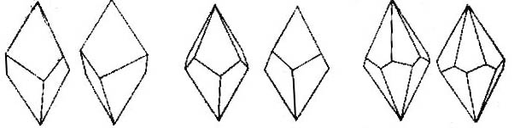
Nomenclature of simple form
Intermediate crystal category- 25 new types
6) Trapezohedron（偏方三八面体）: The crystal facets are diquadrilateral, simlar to dipyramid, intersecting with the high order axis from the top and the bottom but staggering at a certain angle. This class includes: trigonal trapezohedron, tetragonal trapezohedron, hexagonal trapezohedron.

Slide 44
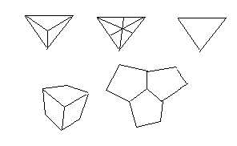
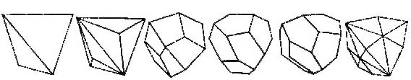
Nomenclature of simple form
Higher crystal category- 15 new types
Tetrahedron（四面体）:
The crystal facets are four equilateral triangles. The equilateral triangles are further divided into three or six triangles, quadrangles and five pentagons. The crystal facets is perpendicular to L³, and the midpoints of crystal edges is perpendicular to L² or L_{i}⁴.
This class includes tetrahedron, triakistetrahedron, deltoid dodecahedron, tetartoid, hexatetrahedron.

Slide 45
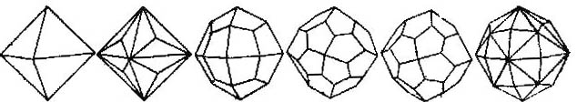
Nomenclature of simple form
Higher crystal category- 15 new types
2) Octahedron（八面体）:
Simple forms of this class consist of eight equilateral triangles. The crystal facet division method is exactly the same as that of tetrahedron class。
This class includes octahedron, triakisoctahedron, tetragonal trisoctahedron, pentagonal icositetrahedron, hexoctahedron.

Slide 46
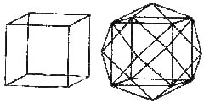
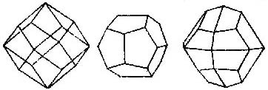
Nomenclature of simple form
Higher crystal category- 15 new types
3) Cube: This class consists of six square crystal facets. The edges intersect at right angles. This class includes two types: cube and tetrahexahedron.
4) Dodecahedron: A granatohedron consists of 12 rhombohedral planes, which are parallel by pairs. The neighbored facets intersect with 120°or 90°. A pyritohedron consists of 12 pentagons. A pentagon has four equal sides and the unequal fifth side. A deltohedron is a twenty-four facet object formed by the vertical equal division of the unequal side of pyritohedron.

Slide 47

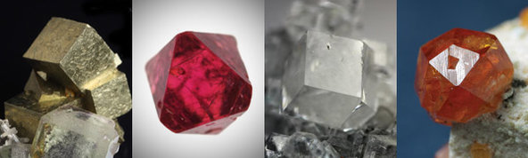
Examples of simple forms from nature minerals
Cube
Octahedron
Granatohedron
Tetragonal trisoctahedron
Pyrite
Spinel
Fluorite
Spessartine
Isometric system

Slide 48
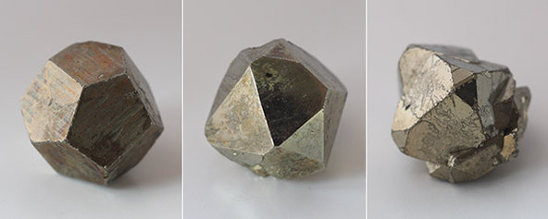
Examples of simple forms from nature minerals
Combined forms of pentagonal dodecahedron and octahedron.

Slide 49



Projection of 47 geometric simple forms
Pedion
Pinacoid
Dome
Trigonal prism
Tetragonal prism
Hexagonal prism
Ditrigonal prism
Ditetragonal prism
Dihexagonal prism
Stereographic forms and stereographic projection of 17 open forms - I

Slide 50



Projection of 47 geometric simple forms
Trigonal pyramid Tetragonal pyramid Hexagonal pyramid
Ditrigonal pyramid Ditetragonal pyramid Dihexagonal pyramid
Rhombic pyramid Rhombic prism
Stereographic forms and stereographic projection of 17 open forms - II

Slide 51
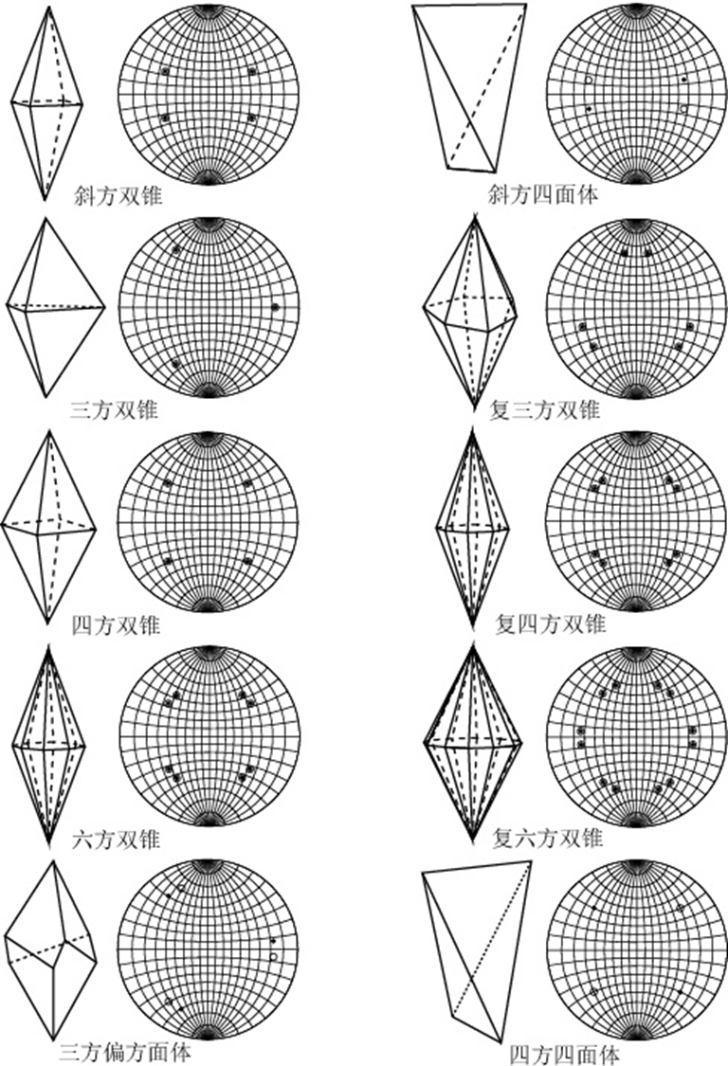
Projection of 47 geometric simple forms
Rhombic dipyramid Rhombohedral tetrahedron
Hexagonal dipyramid Dihexagonal dipyramid
Trigonal dipyramid Tetragonal dipyramid
Trigonal trapezohedron Tetragonal disphenoid
Tetragonal dipyramid Tetragonal dipyramid
Stereographic forms and stereographic projection of 30 closed forms - I

Slide 52




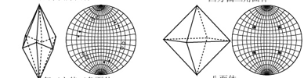
Projection of 47 geometric simple forms
Tetragonal trapezohedron Rhombohedron
Triakisoctahedron Trapezohedron
Hexagonal trapezohedron Tetragonal trapezohedron
Gyroid Hexoctahedron
Ditrigonal scalenohedron Octahedron
Stereographic forms and stereographic projection of 30 closed forms - II

Slide 53

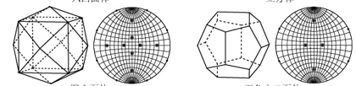
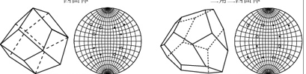


Projection of 47 geometric simple forms
Tetrahedron Triakistetrahedron
Tetrahexahedron Pyritohedron
Deltoid dodecahedron Tetartoid
Diakisdodecahedron Rhombic dodecahedron
Hexatetrahedron Cube
Stereographic forms and stereographic projection of 30 closed forms - III

Slide 54
Chapter VII. Simple form and combined form
(The ideal shape of the crystal)
Simple form and simple form symbol
Theoretical derivation of simple form
47 geometric shapes and 146 crystalline simple forms
Nomenclature of simple form
Category of simple form
Combined form and its analysis

Slide 55
General form and special form（一般型和特殊型）
According to the relative positions of crystal facets of single forms and the symmetry elements in symmetry classes, simple form can be divided as general form and special form;
The form symbols of general form is {hkl} or {hkil};
The crystal facets of general form has a general relationship with symmetry elements;
If crystal facets and symmetry elements are vertical or parallel or intersect with a equal angle, the corresponding crystal shape is a special form;
Each symmetry class only has one general form.

Slide 56
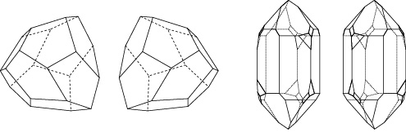
Left-hand form and right-hand form
Simple forms of these two category are the same in morphology while are mirrored in space. They can not be repeated by rotation operation. However, The division of the left and right forms is artificially determined.
Tetartoid
Quartz
Left-hand form and right-hand form

Slide 57
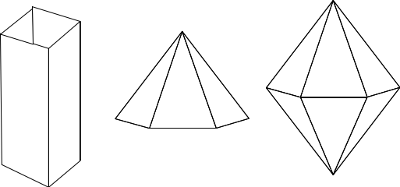
Open form and closed form （开型和闭型）
If all the faces of a single form cannot be enclosed into a closed space, the single form is called as an open form, otherwise as a closed form.
Pedion, pinacoid and all kinds of columns and pyramids, totally 17 belong to open form; There are 30 closed form.

Slide 58
Chapter VII. Simple form and combined form
(The ideal shape of the crystal)
Simple form and simple form symbol
Theoretical derivation of simple form
47 geometric shapes and 146 crystalline simple forms
Nomenclature of simple form
Category of simple form
Combination and its analysis

Slide 59
Combination and its analysis
Combinations:
The aggregation of two or more single forms is called a combination;
In any case, the aggregation of simple forms must follow the principle of symmetry consistency, that is, In 146 crystallography simple forms. Only the single forms belonging to the same symmetry class can be combined together.
Combination analysis:
The shape, size and properties of a simple form are the same;
A combination may most probably be composed of 7 simple forms;
The symmetry of all single forms in a combination belongs to the same point group.

Slide 60
Combinations analysis procedure:
Find all the symmetry elements and determine symmetry class, crystal system and crystal category;
Carry out crystallographic orientation according to the principle;
Determine the number of simple forms, the number of facets of each simple form, and the relation between the symmetry elements and crystal facets;
Determine simple form.

Slide 61
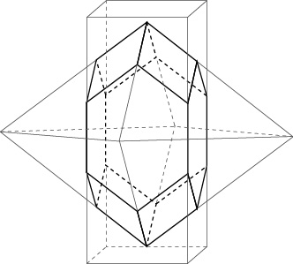
Sketch map of the formation of a combination by a tetragonal column and a tetragonal dipyramid.
Attention:
The crystal facets change dramatically in the combinations. For example, the crystal facets of cubic are not necessarily square and the ones of octahedron are not necessarily triangle.

